Slide 1
The General Service
Conference Structure of
Alcoholics Anonymous

Slide 2
Presentation to GSR's in the U.P of Michigan
Area 74 Northern Wisconsin &
Upper Peninsula of Michigan
By Dodie A
Past Delegate Panel 58 Area 74
and
Bob M
Past East Central Regional Trustee
June 4, 2011

Slide 3
Objectives
Role of the Group & the GSR
Role of the District & the DCM
Role of the Area Committee
Role of the Assembly
General Service Conference Service Structure
Closing Comments

Slide 4
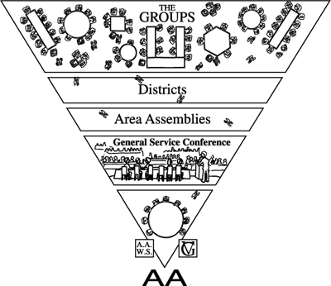

Slide 5
the Home Group
Any Group of alcoholics gathered
together for sobriety may call themselves an A.A. group provided that, as a group, they have no other purpose or affiliation.
Twelve Concepts for World Service, Concept Twelve, Warranty Six

Slide 6
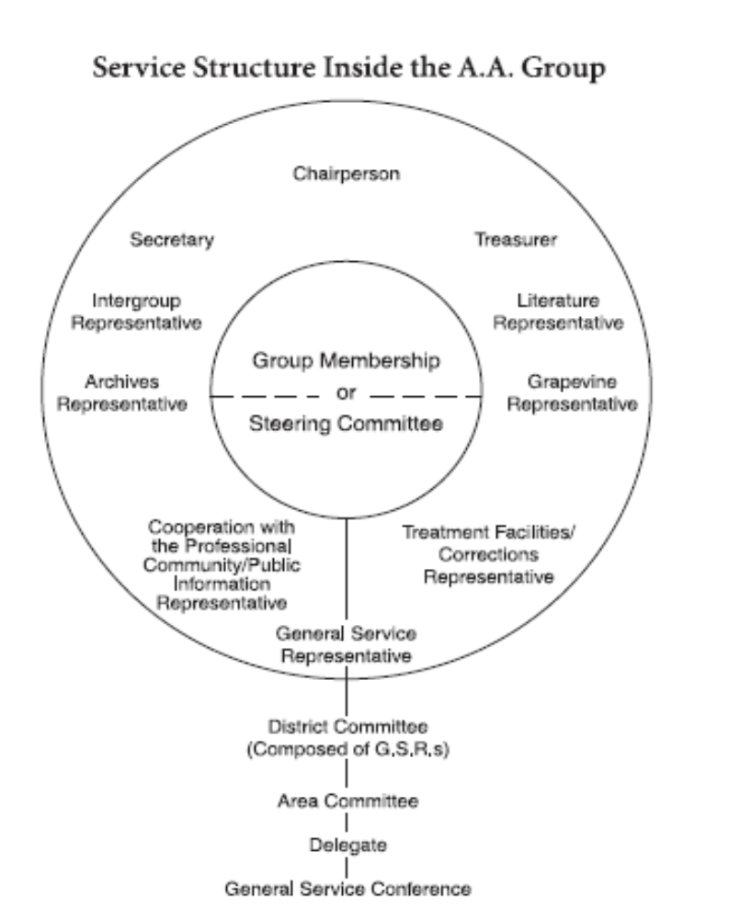

Slide 7
First Concept:
“Final responsibility and the ultimate authority for A.A. world services should always reside in the collective conscience of our whole Fellowship.”

Slide 8

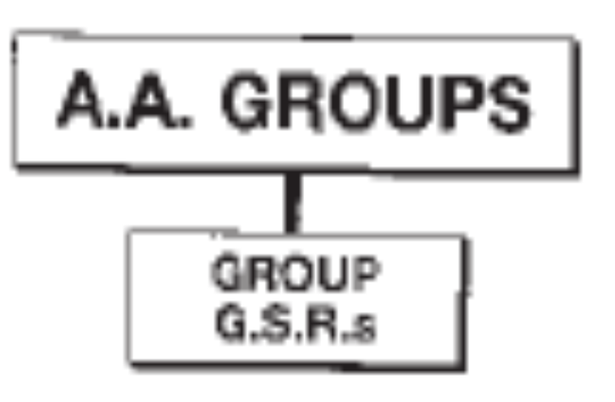

Slide 9
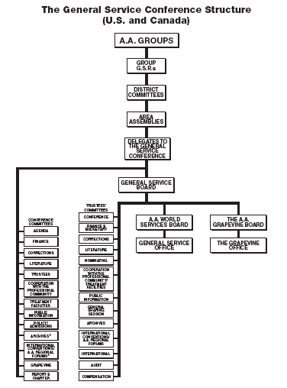

Slide 10
The Role of the GSR
The GSR is the active link between the group and the Fellowship as a whole through the Area Delegate.
The GSR represents the voice of the group conscience.
Communication is a two-way street, making the GSR responsible for bringing back to the group Conference Actions that affect AA unity, health and growth.

Slide 11
Three Distinct Areas of Responsibility
GSR as Trusted Servant in the General Service Structure
GSR as Steward to One’s Home Group
GSR as Chair of the Group’s Business Meeting

Slide 12
GSR as Trusted Servant
To serve as the vital link in communication between the Home Group and AA as a whole, a GSR should attend
      Monthly District meetings
      Area assemblies
      AA service conferences
      Forums

Slide 13
GSR as Trusted Servant
GSR plays a vital role in preparing the Delegate for the annual General Service Conference:
  Make announcements to keep the Home Group aware of matters of interest reported by the Delegate throughout the year.
  Carry the Home Group’s informed group conscience to District meetings and Area assemblies.
  Report General Service Conference Actions back to the Home Group.

Slide 14
GSR as Trusted Servant
GSR plays a vital role in carrying the message outside the four walls of the Home Group’s meeting :
  Participate on a Service Committee by attending break-out sessions at Area Assemblies and by participating in the activities of that committee at the District or Group level.
  Make members of the Home Group aware of opportunities to be of service.

Slide 15
GSR as Trusted Servant
The GSR acts as the primary contact for his Home Group
  with the General Service Office (Group Change Forms)
  for the distribution of flyers for upcoming events
  within the District (Meeting Directory) by mail, phone and now email

Slide 16
GSR as Steward of the Home Group
Make sure the doors are open (Responsibility Statement)
Make sure everyone is welcome (Fellowship)
Home Group primary purpose: carry the message to outside the four walls of the meeting
Guardian of the Traditions

Slide 17
GSR as Chair of Business Meeting
Schedule monthly business meetings following District meetings.
    Prepare an agenda
    Include a Treasurer’s report
    Invite participation
    Chair the meeting

Slide 19
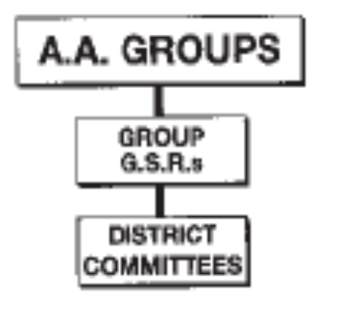
Role of the DCM
(District Committee member)

Slide 20
Qualifications & Commitments
Qualifications:
  Background in AA service work (previous GSR)
  Enough sobriety (generally 4-5 years) to be delegate
  Time and energy to serve
Commitment:
  Usually 2 year term
  Hold monthly district meetings
  Attend Area Committee Meetings
  Attend Assemblies
  Serves on Area Standing Committees
Notes:
The DCM has usually served as a GSR and is elected by other GSRs to take responsibility for district activities. They should have a well-rounded background in AA service work.
A DCM should have enough sobriety, generally 4-5 years to be eligible for election as delegate.
He/she also needs to have the time and energy to do the work required.
If you have trouble fitting service work into your schedule right now, DCM may not be the right position for you.
The term for a DCM is usually 2 years.
As a DCM you will be responsible for holding regular district meetings, usually once a month for the GSRs in your district.
You are also expected to attend four Area Committee Meetings and four Assemblies each year. Each of these events usually takes 8 hours on a Saturday.
You may also be asked to participate on an Area Administrative committee or an Ad Hoc committee. These committees will usually meet once a month and require an additional commitment of time and energy on your part.

Slide 21
The Role of the DCM
Carries collective group conscience to Area Committee
Is responsible for two-way communication between Groups and Area
  Holds regular GSR meetings
  Assists Delegate
  Keeps GSRs informed
  Acquaints GSRs with AA Literature
  Holds workshops and sharing sessions
  Talks to groups regularly
Notes:
The DCM is the vital link between the group’s GSRs and the Area Service Structure. He/she carried the collective group conscience of the AA groups in their District to the Area Committee.
The DCM is also responsible for the two-way communication between the Groups and the Area.
This includes holding regular meetings of all GSRs in the District
You will also be asked to assist the Delegate in obtaining information in time to meet the deadline for AA directories
Another important job is keeping the GSRs informed about Conference activities and anything else that is going on
As DCM you will become intimately familiar with the AA Service Manual, Box 4-5-9, and other AA literature and you are asked to acquaint your GSRs with this literature
You can also hold workshops and sharing sessions on carrying the message of the Seventh Tradition (which is?) to non-supporting AA groups
And it is really important that you talk to Groups regularly about the responsibilities of general service work.

Slide 22
Holding a District Meeting
Printed Agenda
  Info GSRs should take to their Group
  Assembly agenda items
  Frequently asked information
    Answering Service Number
    GSO Address
    Area Address
    District Address
  Next Assembly date, location and map
Trusted Servants List
  Phone numbers and email addresses
  Area Committee Chairs information
District Calendar
Notes:
As DCM I held a monthly meeting for the GSRs in my District. At this meeting the GSRs were given an opportunity to make a report, ask questions, and get information. It is a vital link in the two-way communication responsibility of a DCM.
A sample agenda from one of my district meetings is provided in the back.
I provided a printed agenda that included as much information as I knew ahead of the meeting, so that the GSRs could have something to bring back to their Groups and hold a business meeting. Of course, it didn’t include all the information that came up at the meeting, but it was a good start and gave them an opportunity to take notes of additional information rather than having to take notes of the entire meeting.
When I had the information in advance, I would include the Assembly Agenda Items so the GSRs could take the information back to their group for a group conscience.
I also provided frequently asked information like the answering service phone number and the addresses for GSO, NIA, and the District so that GSRs knew where to send their contributions.
At the end of the agenda, I included the information and map of the location for the next Assembly. I also frequently included information on the next major conference that was coming up on the schedule as a reminder.
One thing that I didn’t do well, but was very important was to keep an updated Trusted Servants List with phone numbers and email addresses for all District Committee Chairs. You could include this information on the Agenda to cut down on additional paper. You could also include NIA Service Committee Chairs information as well.
At the beginning of each year, I provided a calendar based on the NIA calendar that included NIA events as well as the district meeting dates.

Slide 23
Things I Would Do
Invite Service Committee Chairs, Area Delegate, other Area Servants
  15 minute presentation
  Opportunity for GSRs and District Committee Chairs to get to know them
  Share ideas for their committee
Provide a printed agenda with topics and assembly agenda items
Have GSRs report at beginning of meetings
Car pool to Assemblies and Conferences
Be an instigator
Ask people to do specific things

Slide 24
Things I Would Do Different
Let people know I am the DCM when I visit a meeting
Visit more groups
Hold workshops
Get all agenda items out to GSRs on time
Take more time to explain agenda items
Stress to Committee Chairs importance of being active
Setup mentoring program with old/new GSR and Committee Chairs
Provide a sample agenda for a GSR business meeting
Be more selective in the service commitments above and beyond being DCM

Slide 25
GROUP
General Service District
DISTRICT
G.S.R.’s
District Service
Committee Chairs
& Liaisons
D.C.M.’s
The District serves two primary functions: Communication link between Groups, and the Area Committee through the DCM. Districts are geographic subdivisions of the General Service Area and Groups are assigned to DCMs as best to communicate the collective Conscience of those Groups from to the General Service Conference structure and “AA as a whole”.
Archives
Corrections
Activities
Grapevine
Literature
PI/CPC
Treatment
Facilities
District Website

Slide 26
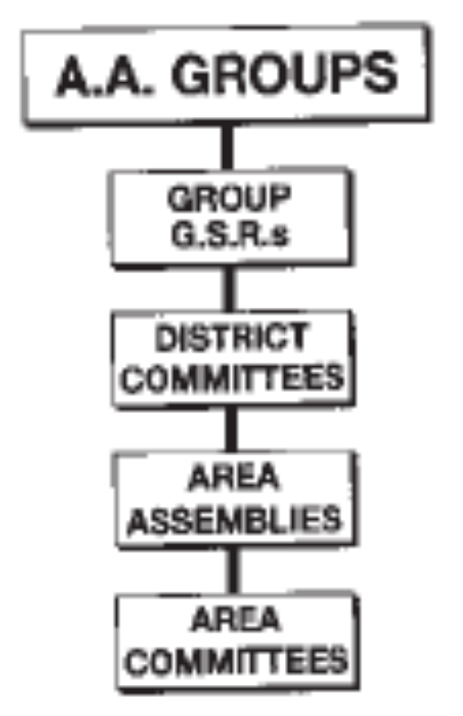
Role of the Area Committee

Slide 27
Area Committee

Slide 28
The Area Committee
Perhaps more than any other group of people in AA, the area committee is responsible for
the health of the Conference structure thus the growth and The harmony in the AA fellowship
If G.S.R.s are lax, if there are difficulties in PI or some other service area, the committee member knows it can turn to the full committee for help
An active Area committee deals with all kinds of service problems.

Slide 29
The Area Committee
Composition:
D.C.M.’s
Area Officers
Chairs of Service Committees
Possibly outgoing Delegate
Possibly Past Delegates (with or without vote)

Slide 30
In Area 74
The Area Committee
Composition:
D.C.M.’s
Area Officers
Chairs of Standing Committees

Slide 31
The Area Officers
Composition:
Delegate
Alternate Delegate
Area Committee Chair
Alternate Area Committee Chair
Treasurer
Alternate Treasurer
Secretary
Alternate secretary
Registrar

Slide 32
In Area 74
The Area Officers
Composition:
Delegate
Alternate Delegate / Area Committee Chair
Treasurer
Secretary / Registrar

Slide 33
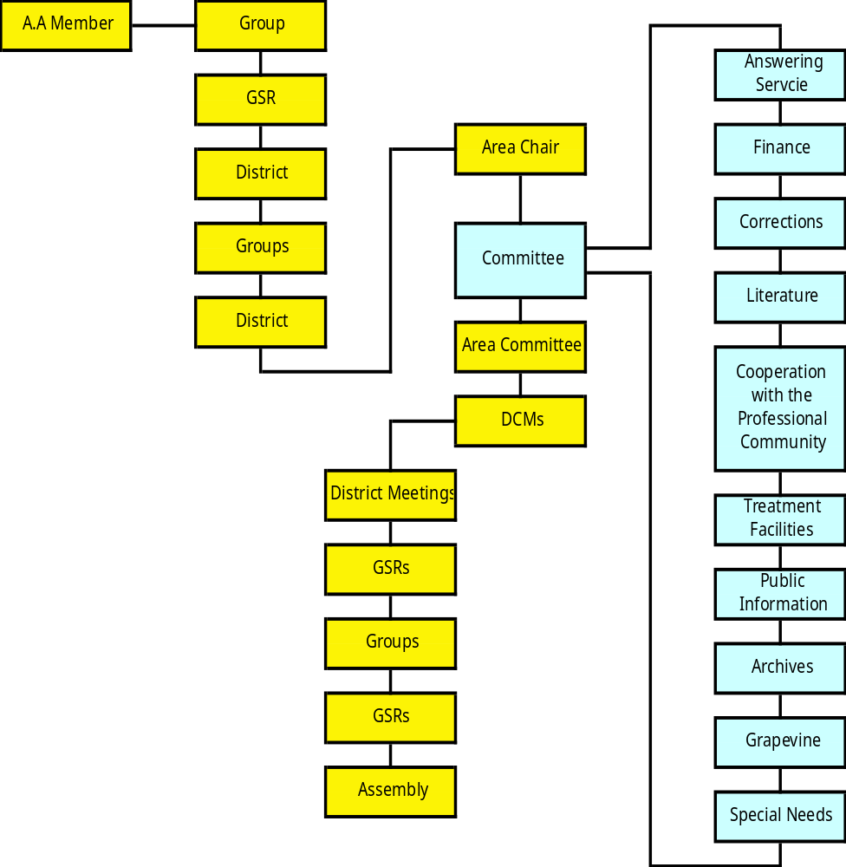
Area Structure

Slide 34
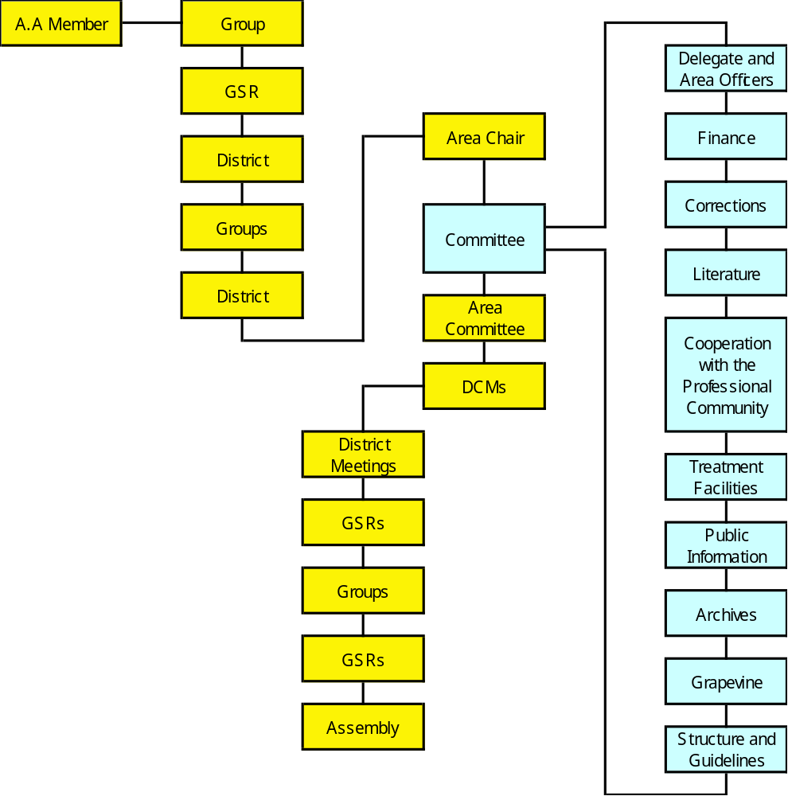
Area 74 Service Structure

Slide 35
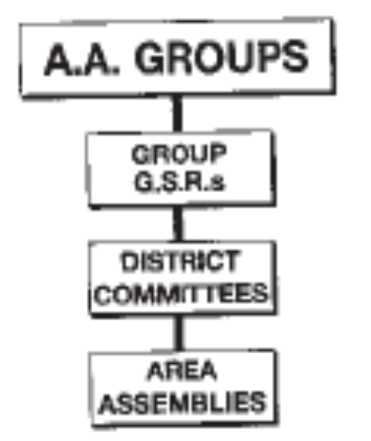
Role of the Area Assembly

Slide 37
The Area Assembly
The Area holds an important middle position in the Conference Structure – through the elected Delegate, it participates in A.A. worldwide, while through the D.C.M.s and the G.S.R.s it is close to the local scene.
Any meeting of Area G.S.R.’s and the Area committee is an assembly
The area assembly is the mainspring of the conference structure – the democratic voice of the movement expressing itself.
Assemblies are the responsibility of the area committee and conducted by its chairperson

Slide 38
The Area Assembly
Composition:
G.S.R.s (Voting)
D.C.M.’s (Voting)
Area Officers (voting)
Chairs of Service Committees (May Vote)
Possibly Past Delegates (May vote)
Other AA members encouraged to attend (No Vote)

Slide 39
The Area 74 Assembly
Composition:
G.S.R.s (Voting)
D.C.M.’s (Voting)
Delegate and Area Officers (voting)
Chairs of Standing Committees (Voting)
Past Delegates (voting)
Other AA members encouraged to attend

Slide 40
GROUP
AREA
ASSEMBLY
DISTRICT
AREA
COMMITTEE
DCMs
Area Service
Committee Chairs
Area Officers
Archives
Directory/Registrar
Corrections
Events/Conventions
Grapevine
Literature
PI/CPC
Special Needs
Treatment
Facilities
Area Website
Area Guidelines
& Handbook
Finance

Slide 41
Area 74 Service Structure
GROUP
AREA
ASSEMBLY
DISTRICT
AREA
COMMITTEE
DCMs
Area Standing
Committee Chairs
Delegate & Area Officers
Archives
Finance
Corrections
Cooperation with Professional
Community
Grapevine
Literature
Public Information
Structure & Guidelines
Treatment
Facilities

Slide 42
Concept One:
Final responsibility and ultimate authority for A.A. world
services should always reside in the collective conscience
of our whole Fellowship.
Alcoholic Foundation
  Providing services by 1948
  Uniform literature
  Public Relations
  Handling inquiries
  Sharing Experience - General Service Office
There is a separation
  Between the foundation and the fellowship
  Bill and Bob fill the gap

Slide 43
Concept Two:
The General Service Conference of A.A. has become, for
nearly every practical purpose, the active voice and the
effective conscience of our whole Society in world affairs.
In 1948 Dr. Bob suffers from a fatal illness
  Becomes clear that Bill and Bob will not be around forever
  November 16th, 1950
1951 - First General Service Conference
  5 year experiment
  1955 Bill turns the Fellowship over to the groups
  The A.A. Groups now fulfill the role that the co-founders did

Slide 44
Concept Six:
The Conference recognizes that the chief initiative and active responsibility in most world service matters should be exercised by the trustee members of the Conference acting as the General Service Board.

Slide 45

The General Service Conference

Slide 47
The General service Conference
The Conference will act for A.A. in the perpetuation and guidance of its world services,
It will also be the vehicle by which the A.A. movement can express its views upon all matters of vital A.A. policy and all hazardous deviations from A.A. tradition.
Delegates should be free to vote as their conscience dictates;
They should be free to decide what questions should be taken to the group level, whether for information, discussion or their own direct instruction.
From Current Conference Charter

Slide 48
Who Makes Up the Conference?
93 Delegates
21 Trustees
  8 Regional
  2 At Large
  4 General Service
  7 Non-Alcoholic
2 A.A.W.S. and Grapevine Directors
16 G.S.O. and Grapevine Staff
Total - 134

Slide 49
Conference Committee System
Conference Committees
Agenda
Cooperation with the Professional Community - CPC
Corrections
Finance
Grapevine - GV
Literature
Policy and Admissions
Public Information - PI
Report and Charter
Treatment Facilities/Special Needs - TF
Trustees
Archives
International Conventions and Regional Forums

Slide 50
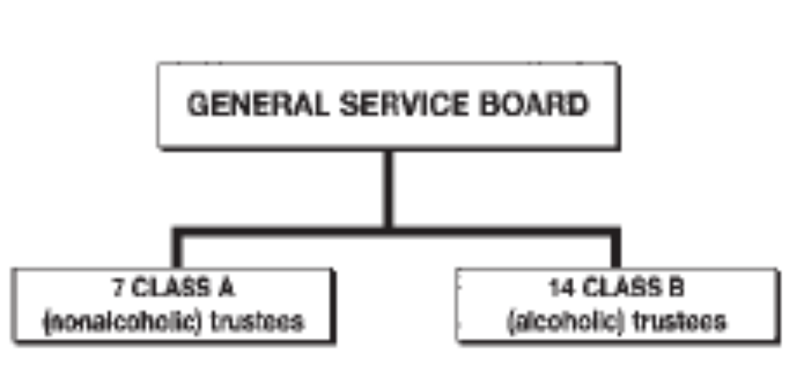
The General Service Board

Slide 52
The General Service Board
The General Service Board (the trustees)
Chief service arm of the Conference,
Essentially custodial in its character . . . Excepting for decisions upon matters of policy, finance, or A.A. Tradition liable to seriously affect A.A. as a whole,
the General Service Board has entire freedom of action in the routine conduct of the policy and business affairs of the A.A. service corporations. . . .
— excerpt from the Conference Charter

Slide 53
General Service Board
There are 21 Trustees
  Fourteen Alcoholic (Class B)
    8 Regional
    2 At-Large
    4 General Service
      2 from A.A.W.S.
      2 from the Grapevine Board
  Seven Non-Alcoholic (Class A)
Trustees comprise the General Service Board
G.S.B. owns A.A.W.S. and the Grapevine
G.S.B. operates the General Service Office

Slide 54
General Service Office
Staff Positions
  Conference Coordinator
  Cooperation with the Professional Community
  Corrections
  Group Services
  International
  Literature
  Nominating
  Public Information
  Regional Forums
  Staff Coordinator
  Treatment Facilities / Special Needs

Slide 55
General Service Office
Services include:
  Box 459
  Loners and Internationalists
  Markings
  Sharing from Behind the Walls
  Corrections Correspondence
  Records
  Service Material
  A.A.W.S. Highlights
  Shared Experience
  Archives
  About AA
Group Handbook
A.A. Directories
Public Information
Anonymity Breaks
Encourages Self-Support
Coordinates the G.S.C.
Organizes Regional Forums
International Conventions
Website
Publications

Slide 56
General Service Conference Structure
GROUP
AREA
ASSEMBLY
Conference
DISTRICT
Finance & Budgetary
AREA
COMMITTEE
GENERAL SERVICE
CONFERENCE
Corrections
DCMs
Area Standing
Committee Chairs
Delegate and
Area Officers
Literature
Nominating
Archives
Finance
Area
Delegates
Directors
GSB
Cooperation w/Professional
Community
& Treatment Facilities
Corrections
Cooperation with
Professional Community
Agenda
Finance
AAWS, Inc.
AA GRAPEVINE, Inc.
Public Information
Corrections
Literature
General Service
Office
Grapevine
Office
General Sharing Session
Grapevine
Literature
Trustees
Cooperation
w/Professional
Community
Archives
Public Information
Structure and
Guidelines
International Conventions
& Regional Forums
Treatment /
Special Needs
Public
Information
Treatment
Facilities
International
Policy
& Admissions
Archives
Audit
The “Big Picture” and how it all fits together.
Notes:
The “Big Picture” … how it all fits together.

Slide 57
How does your Group fit in here?

Slide 58


Slide 59
First Concept:
“Final responsibility and the ultimate authority for A.A. world services should always reside in the collective conscience of our whole Fellowship.”

